Slide 1
Delaying School Start Time on Adolescents' Time Use in South Korea
Dongkyu Yang
Department of Economics
University of Colorado, Boulder
Jaesung Choi
Department of Global Economics
Sungkyunkwan University
Notes:
The effect of delaying school start time on adolescents’ time use and health: Evidence from a policy change in Korea

Slide 2
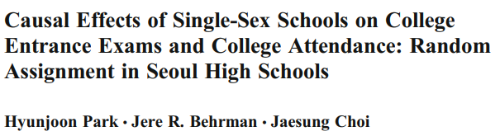
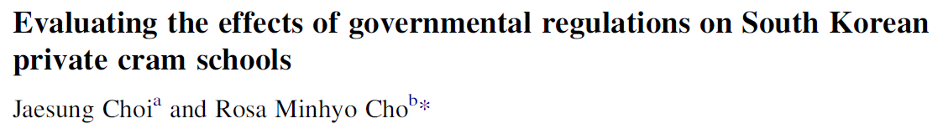
Evaluating Educational Policies in South Korea
Human rights ordinance on student behavior (학생인권조례)
The impact of universal school lunch on student misbehavior (무상급식)
Notes:
Human rights ordinance on student behavior (학생인권조례)
- the right to be free from corporal punishment and physical and verbal violence.
- restrict dress and hairstyle regulations
The impact of universal school lunch on student misbehavior (무상급식, 서울 in 2011)
hold a referendum on free school lunches
“How the imposition of a curfew on private cram schools affects the consumption of private tutoring services as well as the time use patterns of Korean high school students.”
To identify the impact of the curfew, this study capitalizes on inter-city/province variation in private cram school regulatory ordinances and estimates a difference-in-differences estimator
between the years of 2009 and 2012. The findings indicate that the curfew was ineffective in reducing the level of household expenditure or the total number of hours
spent on private tutoring. However, imposition of the curfew was found to be associated with increases in time spent on sleeping as well as in internet usage for nonacademic
purposes. Interestingly, changes in time use patterns were not found among students in the highest socio-economic status group indicating that the curfew policy
may have certain unintended consequences. Policy implications are discussed.

Slide 3
Delaying School Start Time on Adolescents' Time Use in South Korea
Dongkyu Yang
Department of Economics
University of Colorado, Boulder
Jaesung Choi
Department of Global Economics
Sungkyunkwan University
Notes:
The effect of delaying school start time on adolescents’ time use and health: Evidence from a policy change in Korea

Slide 4
Motivation
Recommended sleep time for ages 14-17 is 8-10 hours (National Sleep Foundation, 2006)
Severe sleep deprivation among Korean students
Sleep duration of academic high school students on weekdays is 2.5 hours less than their counterparts in US (BLS, 2018)
Notes:
The newly elected superintendent put a strong drive on the policy.
연령대별 권장 수면시간, 내 나이 가장 적절한 수면량은 몇시간?
http://news.donga.com/BestClick/3/all/20150203/69457495/1
Sleep deprivation among Korean students is known to be quite severe. Although
recommended sleep time for ages 14-17 is 8-10 hours, sleep duration of academic high school
students is about 5.5 hours, which is approximately two hours less than their counterparts in
US and China.
"A national survey of adolescents found that adolescents in high school reported sleeping on average 7.2 h on the typical school night (National Sleep Foundation, 2006), less than the 8–10 h each
night recommended by the National Sleep Foundation (Hirshkowitz et al., 2015)."

Slide 5
Motivation
Previous studies reported associations between sleep time (sleep deprivation) and
Health: Obesity, mental health (suicidal ideation), daytime functioning, mortality risk (e.g., Chen et al. 2006; Dahl et al. 2002)
Academic outcomes (e.g., Carrell et al. 2011)
Efforts were made to introduce a delay in the school start time into a policy
To help students to sleep more
(consequently) to have positive impacts on health and academic outcomes
Notes:
adolescents’ brains are still developing and that chronic sleep deprivation increases the risk of diseases later in life.
circadian rhythm (24시간 주기 리듬)

Slide 6

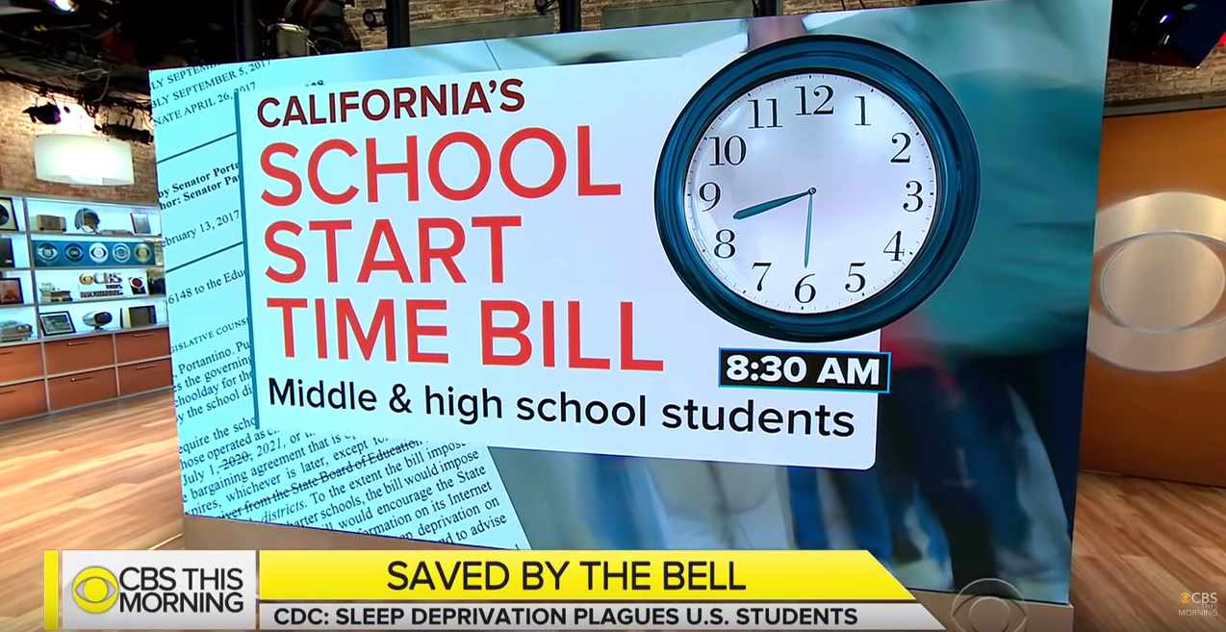
Motivation
“Later Start Times For California Middle, High Students Signed Into Law” (CBS, Oct., 2019)
A new law pushed back start times at most public middle and high schools, no earlier than 8:30 a.m (NY Times, 2019)
“Seattle high schools find later start time improves academic performance” (Dec., 2018)
Notes:
“California Tells Schools to Start Later, Giving Teenagers More Sleep” (NY Times, Oct, 2019) - Most middle schools and high schools across California will start no earlier than 8:30 a.m.”
“Why California is considering later school start times” (Sep, 2018)
“Teens need later school start time, doctors say” (Aug, 2014)

Slide 7
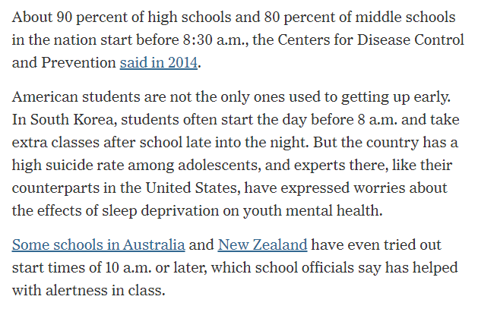
Motivation
“California Tells Schools to Start Later, Giving Teenagers More Sleep” (NY Times, Oct, 2019)

Slide 8
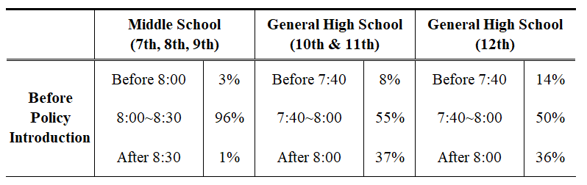
School Starting Time before the policy (Gyeonggi)
Notes:
이재정, 조희연 교육감
South Korea consists of 17 provincial/metropolitan regions, and a 4-year term elective head of the Office of Education is responsible for making and implementing educational policies to his district.
A nationwide election was held in June 2014, and a liberal candidate Jae-Jung Lee was elected as an education superintendent of Gyeonggi province. Right after his inauguration, he encouraged schools in the district to adopt the 9 o’clock attendance policy beginning from the fall semester in 2014.
In fact, students of the Uijeongbu girl’s middle school first proposed the policy.
They posted the idea on a free bulletin on the website of the Gyeonggi Provincial Office of Education, and the newly elected superintendent
Jae-Jung Lee accepted their suggestion. He sent an official document to all schools to introduce the school starting time, although principals of school commonly determine the class starting schedules under their autonomy.

Slide 9
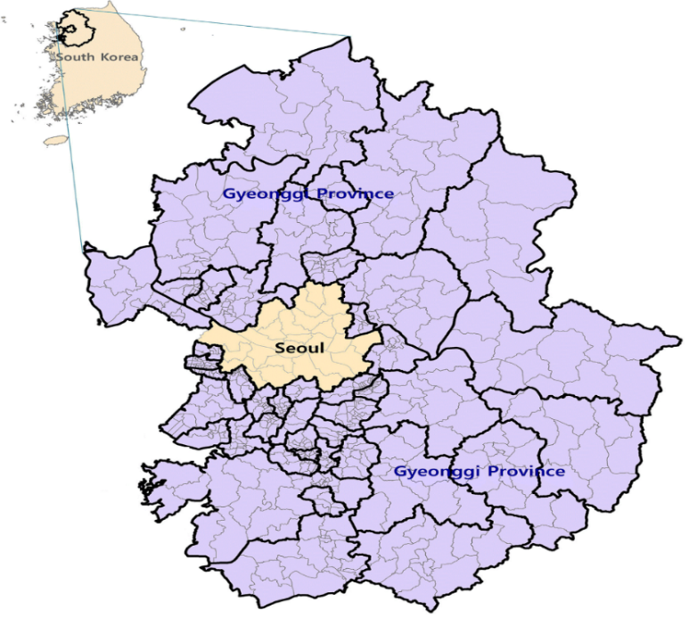
Introduction of a Policy
Gyeonggi 9 o’clock attendance policy
The newly elected superintendent put a strong drive on the policy after regional election on June 2014
Immediately delayed the school start time to 9 am from 2014 fall semester
Average delay of 45 minutes
99.1% middle schools, 88.9% high schools adopted the policy as of 2015
In contrast, Seoul did not prioritize the changes, and less than 4% of schools delayed school starting time in 2015
Notes:
이재정, 조희연 교육감
South Korea consists of 17 provincial/metropolitan regions, and a 4-year term elective head of the Office of Education is responsible for making and implementing educational policies to his district.
A nationwide election was held in June 2014, and a liberal candidate Jae-Jung Lee was elected as an education superintendent of Gyeonggi province. Right after his inauguration, he encouraged schools in the district to adopt the 9 o’clock attendance policy beginning from the fall semester in 2014.
In fact, students of the Uijeongbu girl’s middle school first proposed the policy.
They posted the idea on a free bulletin on the website of the Gyeonggi Provincial Office of Education, and the newly elected superintendent
Jae-Jung Lee accepted their suggestion. He sent an official document to all schools to introduce the school starting time, although principals of school commonly determine the class starting schedules under their autonomy.

Slide 10
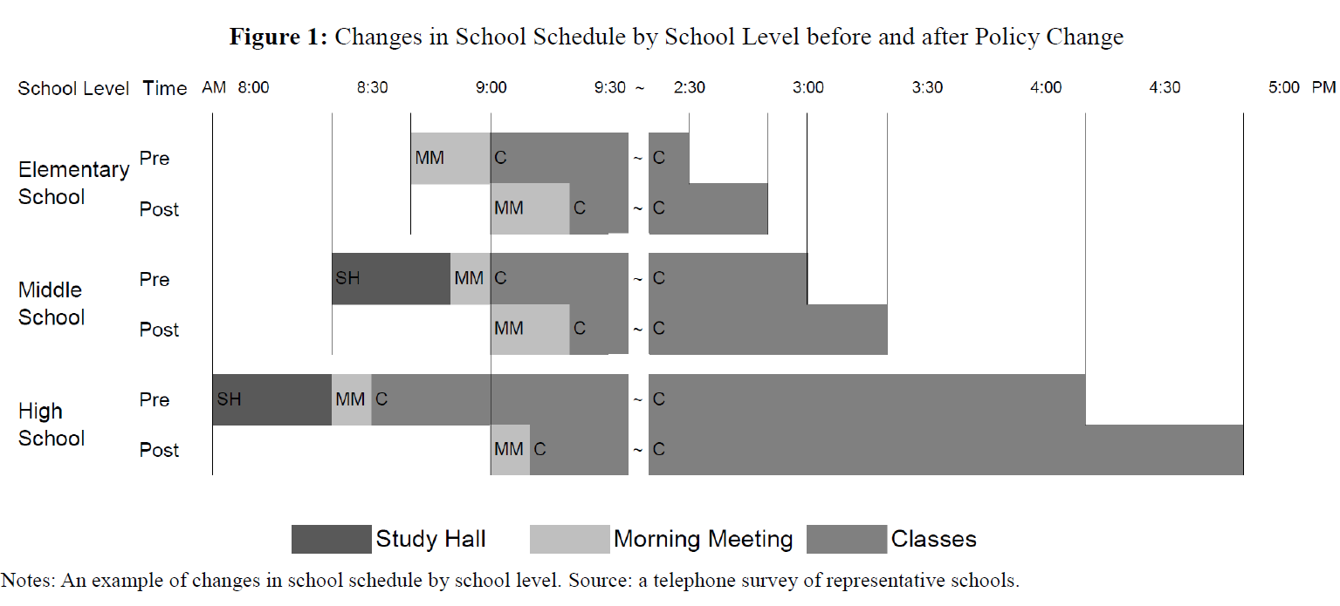
Time Schedule, Before and After
Source: Shin (2018)

Slide 11
Introduction of a policy
Sharply divided opinions on the policy
(Controversy over ′9am School Start′ in Arirang TV, Sep 2, 2014)
Proponents:
Students will sleep more and have a leisurely breakfast
This will improve their health and concentration
Opponents:
Lead to poorer academic performance due to the shortening of time spent in school for self-study or extra classes
More time spent on private supplementary education and other non-academic activities at night (e.g., more games and smartphone use)
Concerns for dual-income families for leaving young students unattended
Notes:
이재정(이전 교육감은 김상곤), 조희연 교육감(곽노현->문용린)
The newly elected superintendent put a strong drive on the policy.
Before the policy, only 1% of middle schools and no high schools set their school start time at 9 am. However, in the fall semester of the same year, 571 (94.5%) middle schools out of 604, and 302 (67.0%) high schools out of 451 changed their start time to 9 am (GOE 2014). Furthermore, 99.1% of middle schools and 88.9% of high schools adopted the policy in spring 2015. In Seoul, however, the Seoul Metropolitan Office of Education did not prioritize these changes. In consequence, no schools adopted the policy in 2014, and only a few middle schools (3.6%) and no high schools adopted the policy in 2015. The sudden introduction of the 9 o’clock attendance policy in Gyeonggi minimizes confounding influences as the rapid implementation would not have provided enough time for students and parents to prepare or make any changes in advance.

Slide 12
Research Question
Previous studies (Kim 2018; Shin 2018) on the policy focus on
The mean effects on sleep time (+): Any heterogeneous effects or which components would drive the change?
Academic outcomes (+): How about other activities and health outcomes?
Does delaying school starting time affect students’
sleep behavior?
time use on other activities?
(health outcomes?) : sleep satisfaction, subjective health, stress level, height
Are there any differential impacts by socioeconomic backgrounds?
What could be a potential mechanism?
Notes:
Recent studies on the policy focuses on sleep time and academic outcome (Kim, 2018; Shin, 2018)
Increased sleep time (KCYPS, KTUS)
Increased academic performance (NAEA, CSAT)

Slide 13
Data_KYRBS
Korea Youth Risk Behavior Web-based Survey (KYRBS, 2011~2017)
Cross-sectional, web-based survey to understand health behavior of Korean teenagers (similar to YRBSS in the U.S.)
Conducted between May and July (The policy was introduced in Sep. 2014) ⇒ 2011~2014 (pre-treatment) vs.
2015~2017 (post-treatment)
Sample: 146,248 secondary school students living in Seoul and Gyeonggi
Used to estimate the policy impact on sleep behavior and health outcomes
Question on sleep behavior (answers in minutes):
“For the past weekdays (weekends), when did you go to sleep and when did you wake up?”
Notes:
Studies of myself, friends, and society

Slide 14
Descriptive Analysis_KYRBS
Changes in Sleep Patterns of Adolescents
The curve for Gyeonggi shifts to the right after the policy
Students in Gyeonggi slept later and woke up later in 2015 compared to 2014
Notes:
Studies of myself, friends, and society

Slide 15
Descriptive Analysis_KYRBS
Change in Sleep Patterns of Adolescents
Show a similar trend before the policy implementation (2011–2014)
However, sleep schedule diverges after the policy introduction
Wake-up time among students in Gyeonggi was even more delayed, outweighing the difference in bedtime
Notes:
Figure 1 shows trends in sleep time of students from 2011 to 2017 using KYRBS. A vertical line between 2014 and 2015 represents the timing of the adoption of the 9 o’clock attendance
policy in Gyeonggi province. Panels A to C show a common trend before the policy implementation (2011–2014).
However, sleep schedule diverges after the policy introduction (Panel A). Bedtime among students in Gyeonggi was delayed compared to students in Seoul (Panel B), and wake-up time among students in Gyeonggi was even more delayed, outweighing the difference in bedtime (Panel C). As a result, total sleep time among students in Gyeonggi
increased relative to students in Seoul.

Slide 16
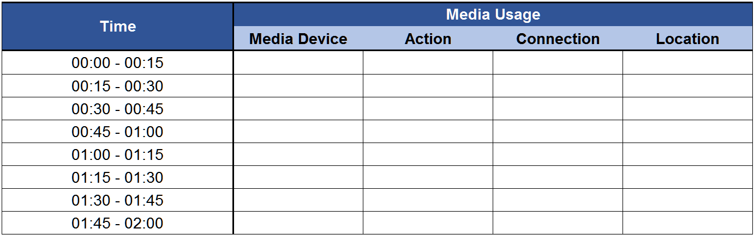
Data_Korea Media Panel
Korea Media Panel (KMP, 2011~2017)
Examine media usage in detail
Media diary: record of media consumption every 15 minutes for three days ⇒ Time spent on electronic devices (computer, smartphone, TV) at home from 8 pm to bedtime
Conducted between May and July
⇒ 2011~2014 (pre-treatment) vs. 2015~2017 (post-treatment)
Sample: 4,643 person-year observations, living in Seoul and Gyeonggi
Notes:
Collected by Korea Information Society Development Institute.

Slide 17
Descriptive Analysis_Korea Media Panel
Change in Electronic Device Usage of Adolescents
Students in Gyeonggi increased the use of electronic devices after the policy introduction (10:45pm: 37.5% -> 42.5%)
Notes:
10:45p: 37.5% -> 42.5%

Slide 18
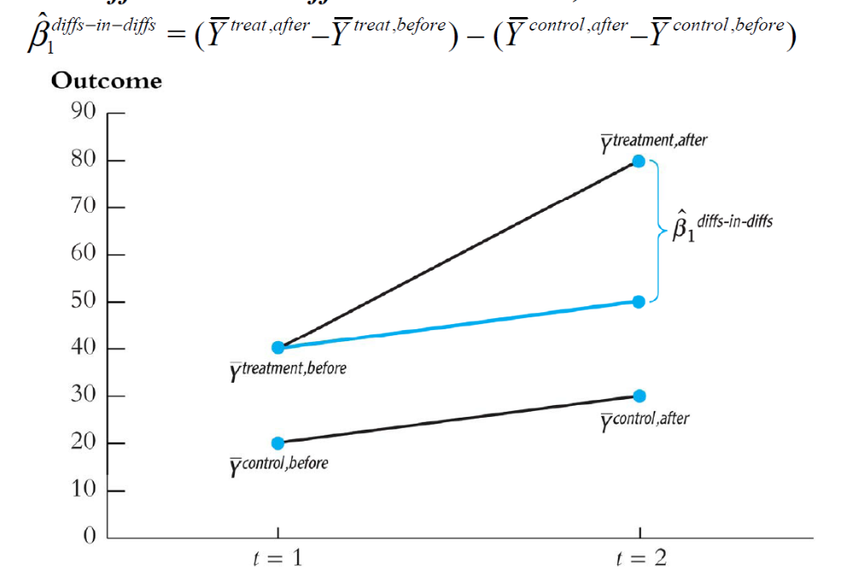
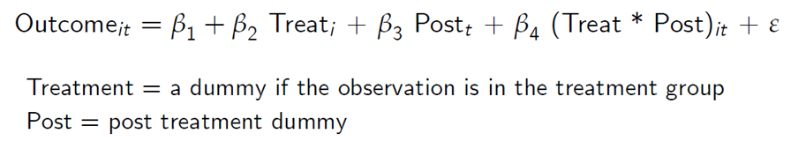
Difference in Differences (DID) Estimation
 | Before | After | Difference
Treatment | a | a+c+X | c+X
Control | b | b+c | c
Difference | a-b | a+X-b | X

Slide 19
Estimation Strategy
Differenece-in-Differences (DID)
y_{ist} = α + βX_{ist} + δd_{st} + λ_{s} + λ_{t} + ε_{ist}
- d_{st} : indicator equals 1 if region s at time t is subjected to the policy
(=Gyeonggi X Post)
- X_{ist} : set of individual, household, and school characteristics
- λ_{s} : region fixed effects
- λ_{t} : year fixed effects
Control Variable
Individual
Characteristics
age, gender
socioeconomic status (SES), parental education number of parents living together
general high schools, vocational high schools
Household
Characteristics
School
Characteristics

Slide 20
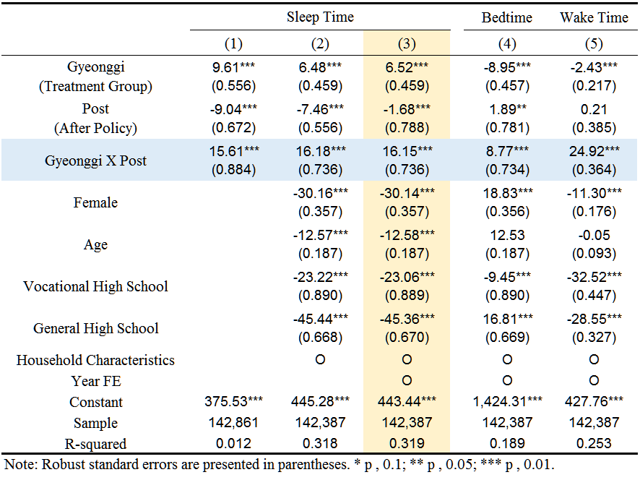
Result 1_Change in Sleep Behavior
Increase sleep hours 16.2 minutes on weekdays
Decrease sleep hours 12.7 minutes during the weekend
→ More balanced sleep schedule throughout a week
Notes:
Studies of myself, friends, and society

Slide 21
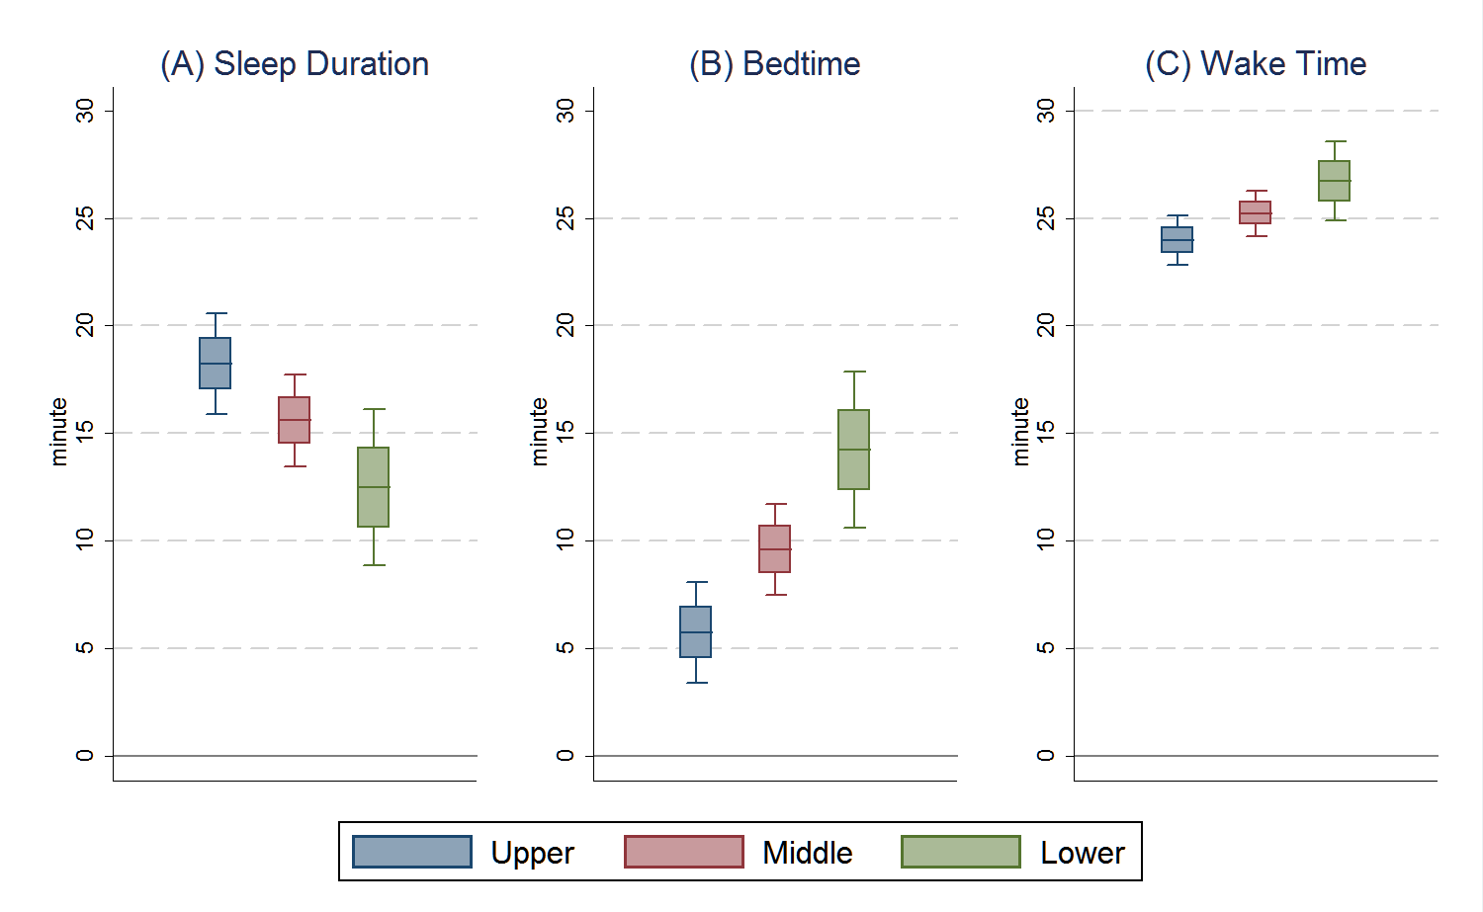
Result 2_Heterogeneity in Sleep Time
Any differential impacts by socioeconomic backgrounds?
The better students’ backgrounds are, the more positive effects they enjoy due to the policy change
Students with higher SES increased sleep time more
The differences in sleep duration by SES is mainly driven by bedtime
Students with higher SES slept more even before the policy
Notes:
Students with higher SES slept more even before the policy (high SES: 6.40 hours, middle SES: 6.33 hours, low SES: 6.17 hours)

Slide 22
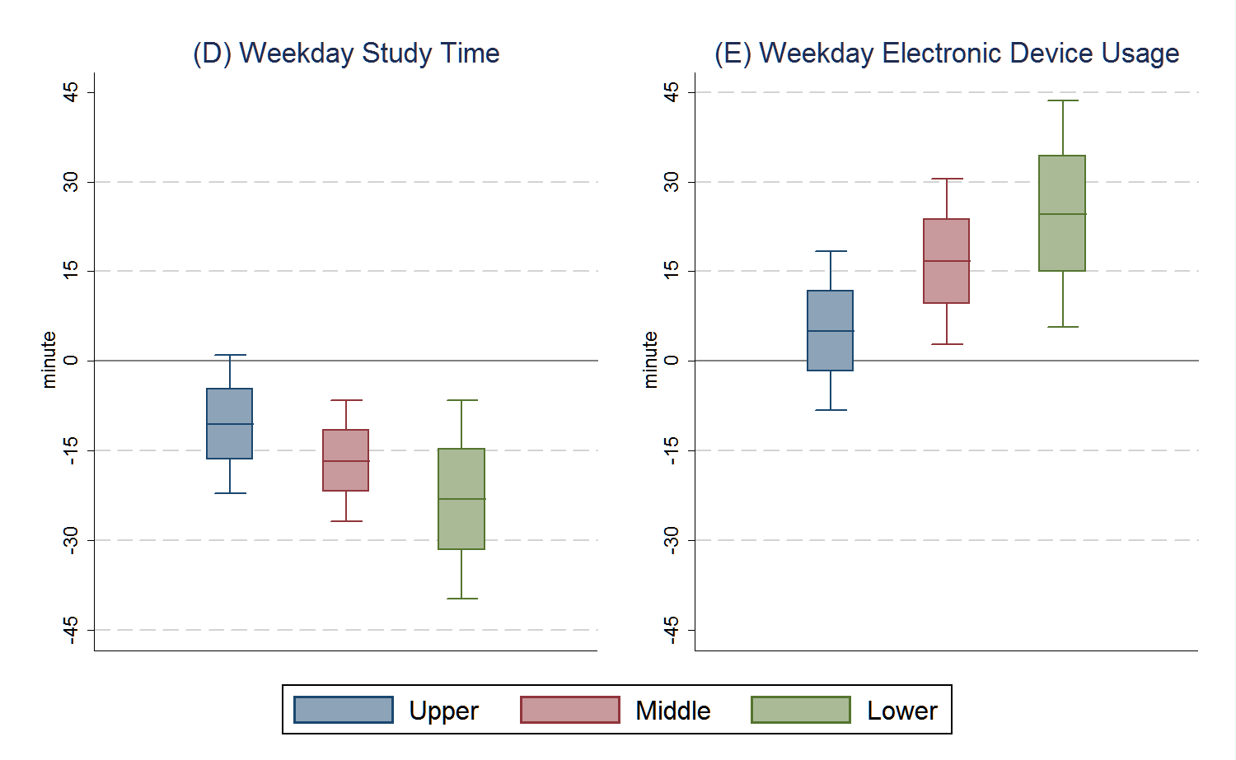
Result 3_Heterogeneity for Other Activities
How about other activities?
Students with lower SES decreased study time more
Students with lower SES increased time for electronic device usage more

Slide 23
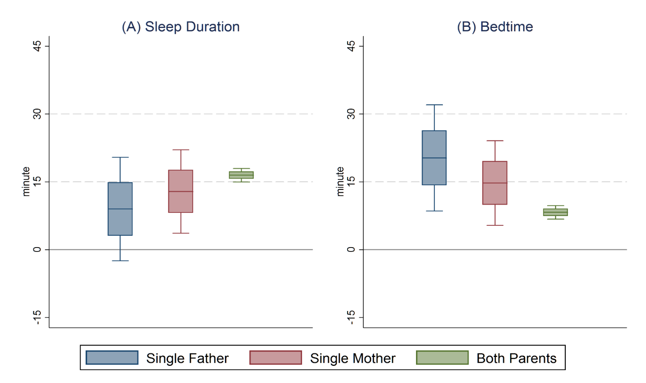
Potential Mechanism 1_Parental Monitoring
Would the disparities by SES reflect any differences in the degree of parental guidance and involvement?
→ Examine differentials by the Composition of Household
Increase in sleep duration: Single Fa < SMa < Both P (9 min vs 16.5 min)
Delay in time to bed: Single Fa > SMa > Both P

Slide 24
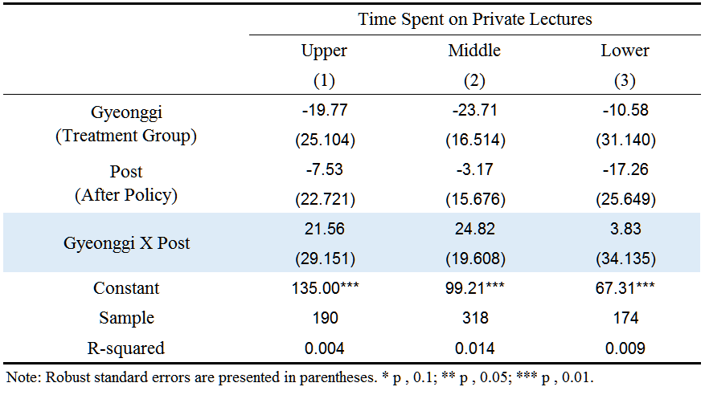
Potential Mechanism 2_Private Education
Any differentials in time use of Private Supplementary Education?
Korea Time Use Survey 2014 (Sample: 682 students)
Conducted three times: July (29.3%) vs. Sept. (45.6%), Nov. (25.1%)
(Although insignificant due to the small samples,) differential impacts by SES on the time spent on private supplementary education was observed

Slide 25
Discussion
Main findings:
Delaying school start time about 45 minutes
students sleep 16.2 minutes more
increased time spent on electronic devices at night
(improved physical and mental health outcomes)
Differential impacts in favor of those from higher SES
Lower SES: sleep less, study less, electronic devices more
Potential mechanisms:
Parental monitoring: household composition
Spending on education: differential use of private supplementary education
Notes:
in the interest of time

Slide 26
Discussion
Implication:
Any unintended consequences?
The policy change further widened the preexisting gap in study and sleeping time by SES
Despite the reported positive mean effect in Kim (2008) and Shin (2008), there can be a growing gap in academic outcomes by SES & possibly negative impacts for those with lower SES
Robustness Checks:
6 other metro areas as a control group
Leads and lags (event study framework)

Slide 27
Appendix

Slide 28
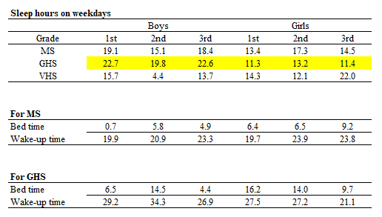
By Grade and Gender for Sleep Hours

Slide 29
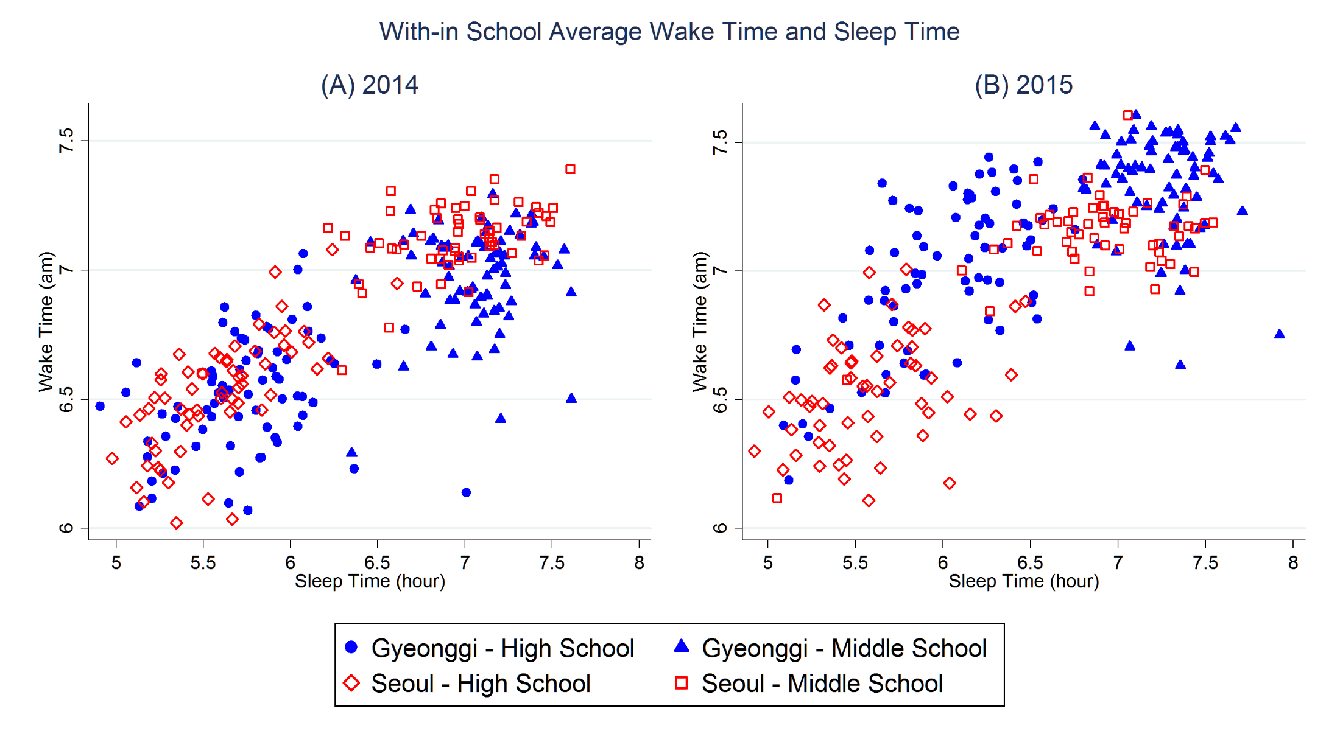
Data_KYRBS
Change in Within School Average Wake-up and Sleep Time
- Average wake-up time for middle and high schools in Gyeonggi have been delayed
- Average sleep time for schools in Gyeonggi have been increased
Notes:
Studies of myself, friends, and society

Slide 30
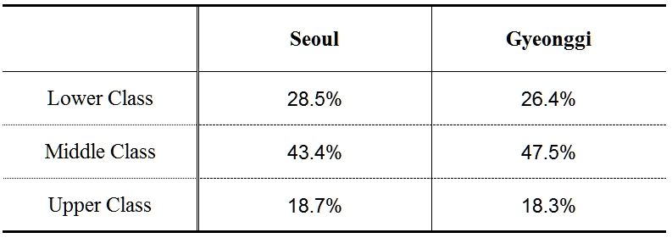
Result 2_Socioeconomic Backgrounds of Students
Korea Youth Risk Behavior Web-based Survey
Classified ① Low and ② Lower-middle as ‘Lower Class’ (35.7%),
③ fair as ‘Middle Class’ (45.7%), and
④ Upper-middle and ⑤ High as ‘Upper Class’ (18.6%)
Survey Question: What is the economic condition of your family?
① Low (8.5%) ② Lower-middle (27.3%) ③ fair (45.7%)
④ Upper-middle (14.9%) ⑤ High (3.7%)
Notes:
* lectures taken at private tutoring institutions plus private tutoring at home

Slide 31
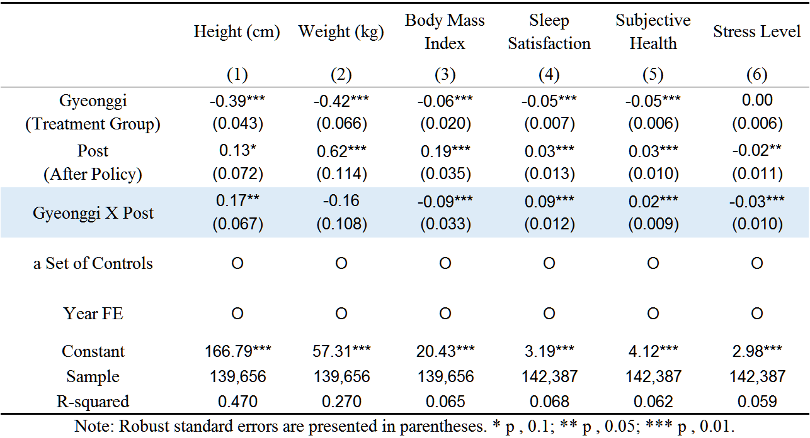
Result 1_Change in Physical and Mental Health
Delaying school start time improved students' physical health
and emotional wellbeing
- Heights of students in Gyeonggi increase 0.17 cm more
- Also contributes to improvements in mental health outcomes
(Sleep Satisfaction: 0.1 std↑, Subjective Health: 0.03 std↑, Stress Level: 0.03 std↓)

Slide 32
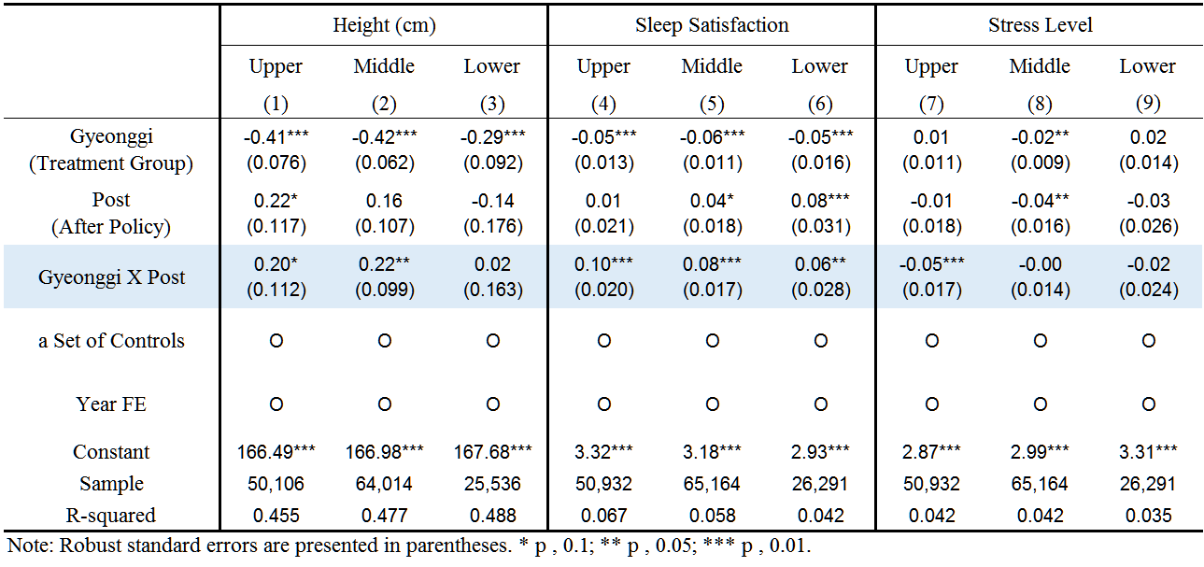
Result 2_Impacts on Physical and Mental Health by SES
Change in physical and mental health by SES
- positive correlation between increase in sleep time and improvements in
physical and mental health outcomes
Notes:
Studies of myself, friends, and society

Slide 33
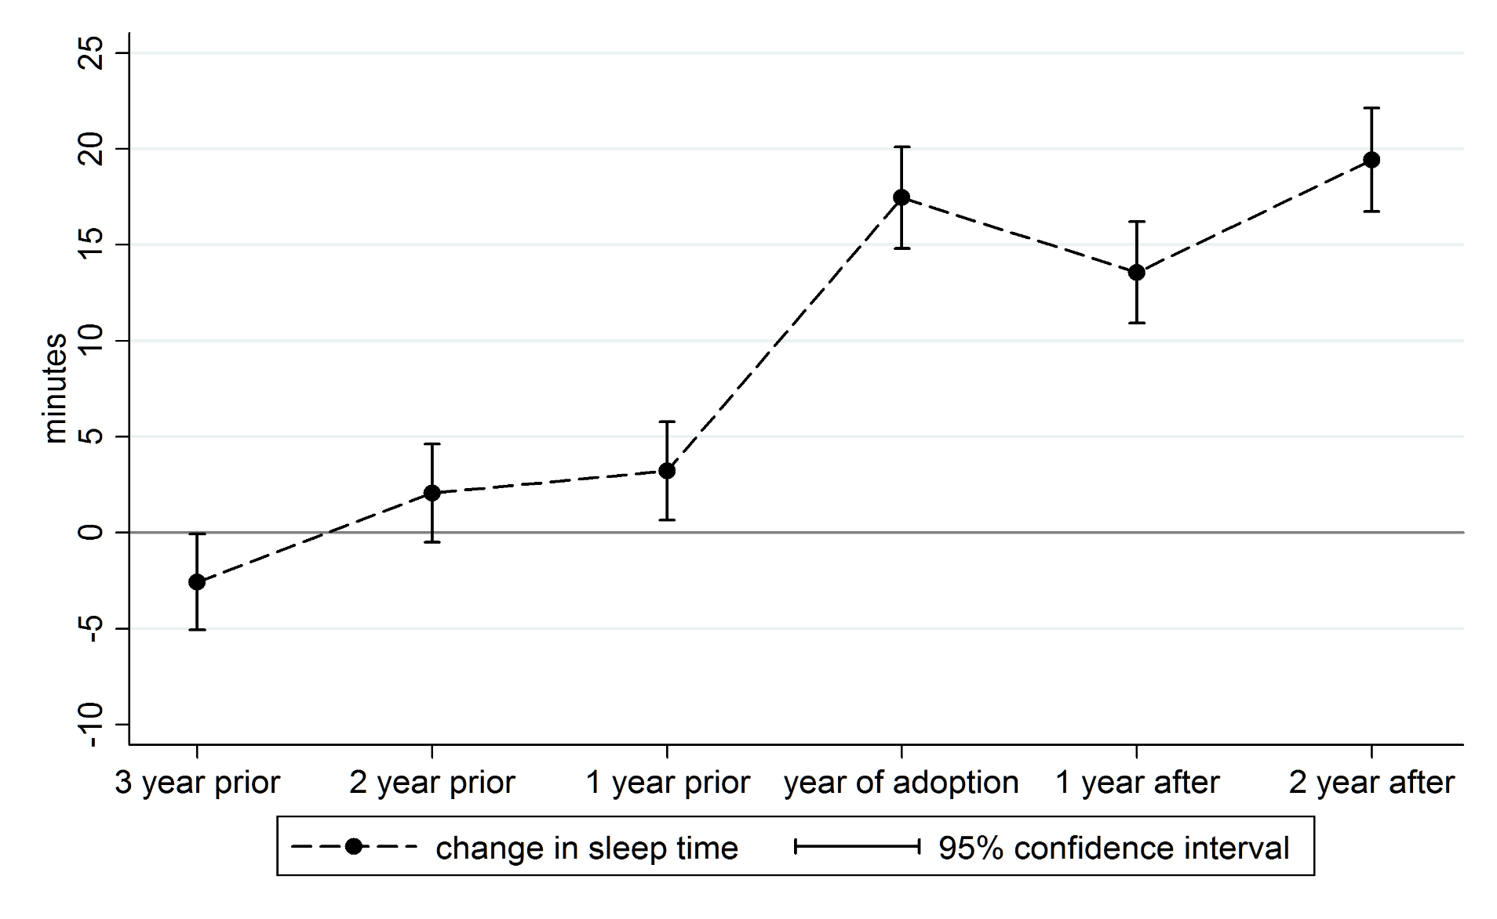
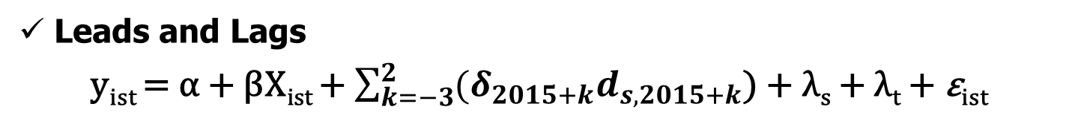
Robustness Check_Leads and Lags
Leads and Lags
y_{ist} = α + βX_{ist} + $\sum_{k=−3}^{2}{{(δ}_{2015+k}d_{s,2015+k}}$) + λ_{s} + λ_{t} + ε_{ist}

Slide 34
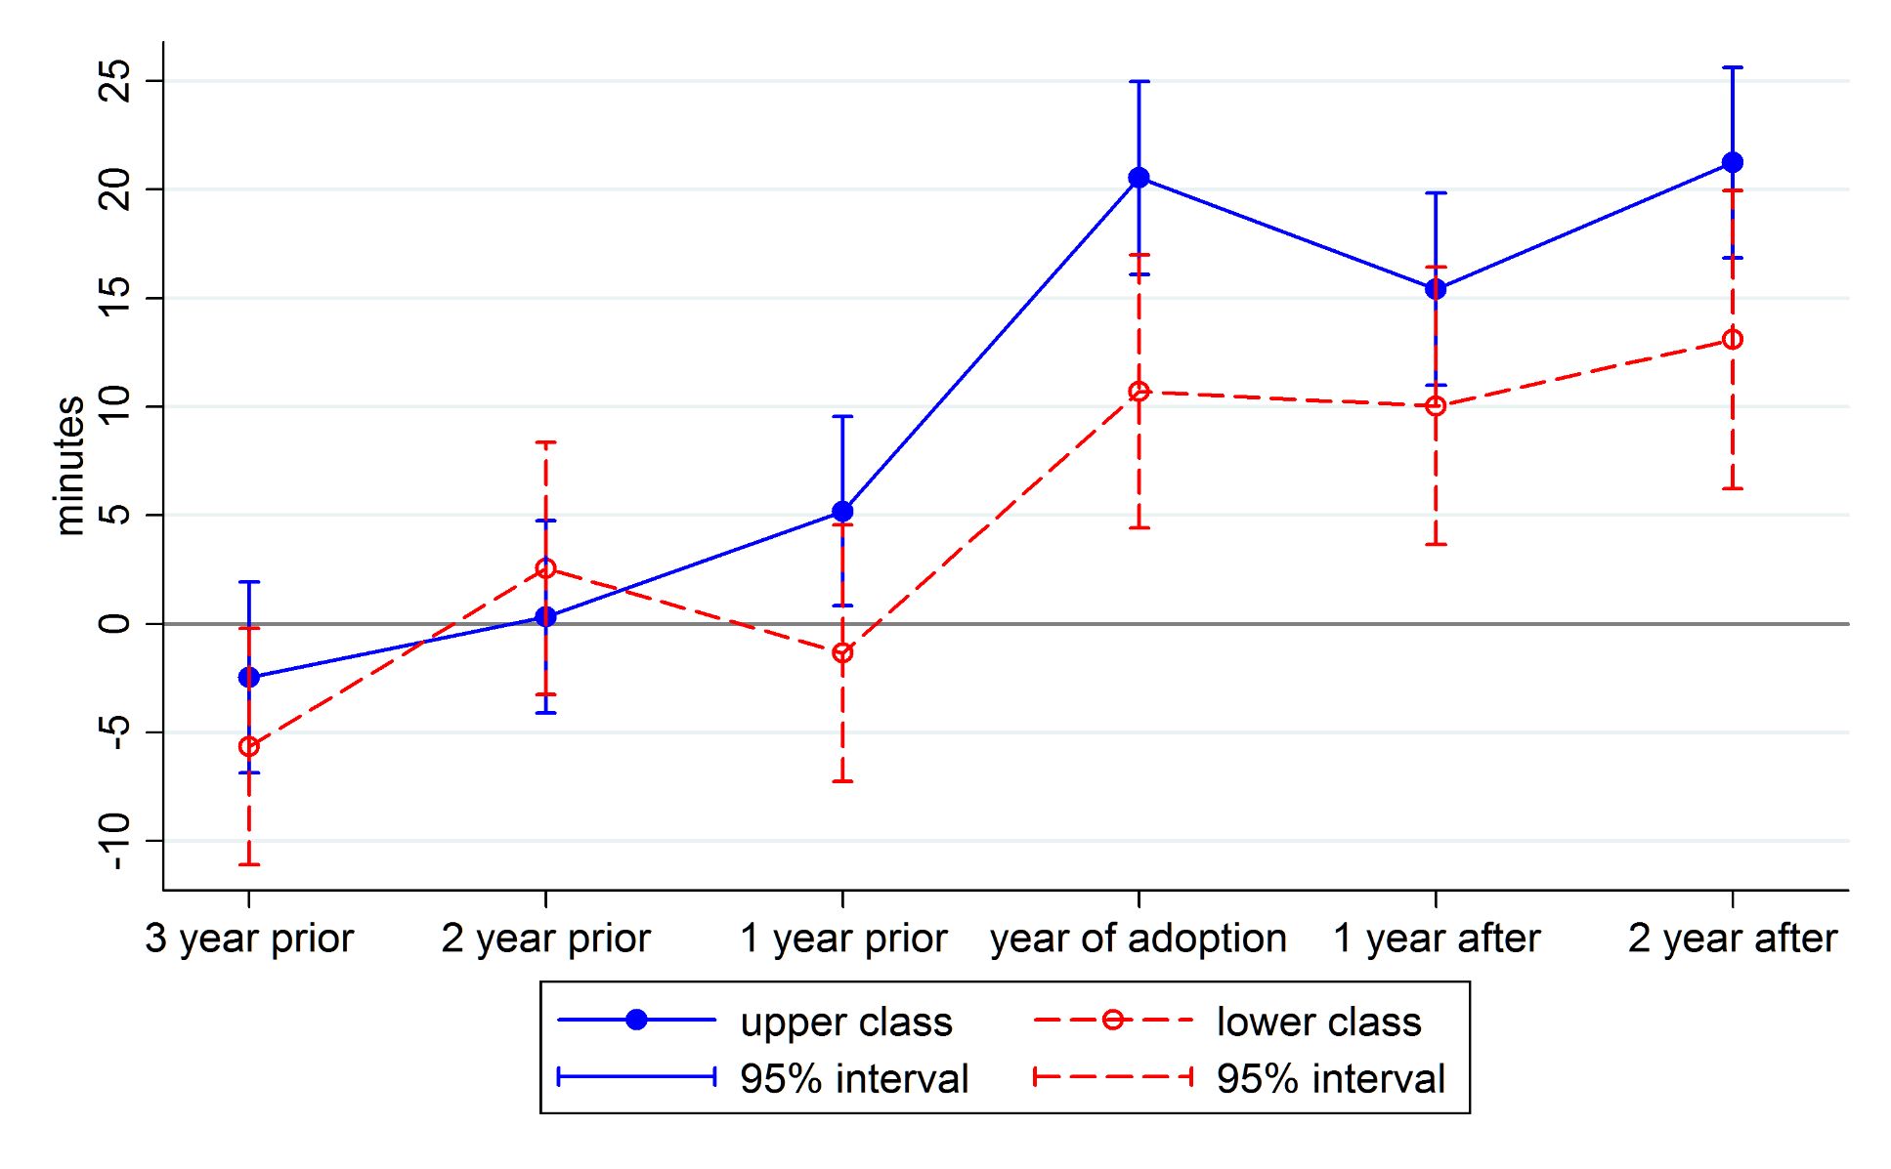
Robustness Check_Leads and Lags
Leads and Lags
dynamics of the policy effects on sleep time by SES

Slide 35
Kim (2018)

Slide 36
Kim (2018)

Slide 37
Jung (2018)

